Slide 1
Making more of nature's most nearly perfect food: 65 years of dairy cow improvement
John B. Cole
Madison West Kiwanis | February 6, 2026

Slide 2
Topics
Dairy farms and breeds in 2026
How has productivity changed over time?
What made these gains possible?
What will the future look like?

Slide 3
Dairy farms and breeds in 2026

Slide 4
New York
630,000
Wisconsin
1,266,000
Pennsylvania
465,000
California
1,709,000
Louisiana
8,000
Texas
675,000
Texas
262,205
Milk Production (December 2025), USDA, National Agricultural Statistics Service
States with >200,000 DHI cows (01/2025)

Slide 5
New York
365,639
Wisconsin
700,531
Pennsylvania
281,931
California
788,794
Louisiana
2,025
Texas
317,701
Texas
262,205
States with >200,000 cows enrolled in a milk recording program (01/2026)
States with >200,000 DHI cows (01/2025)

Slide 6
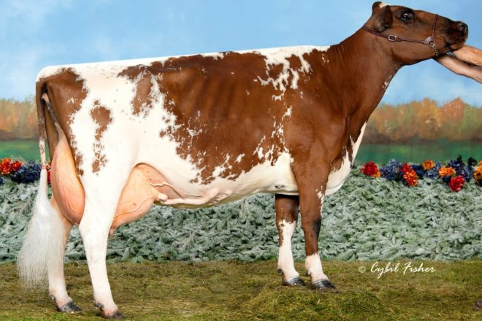
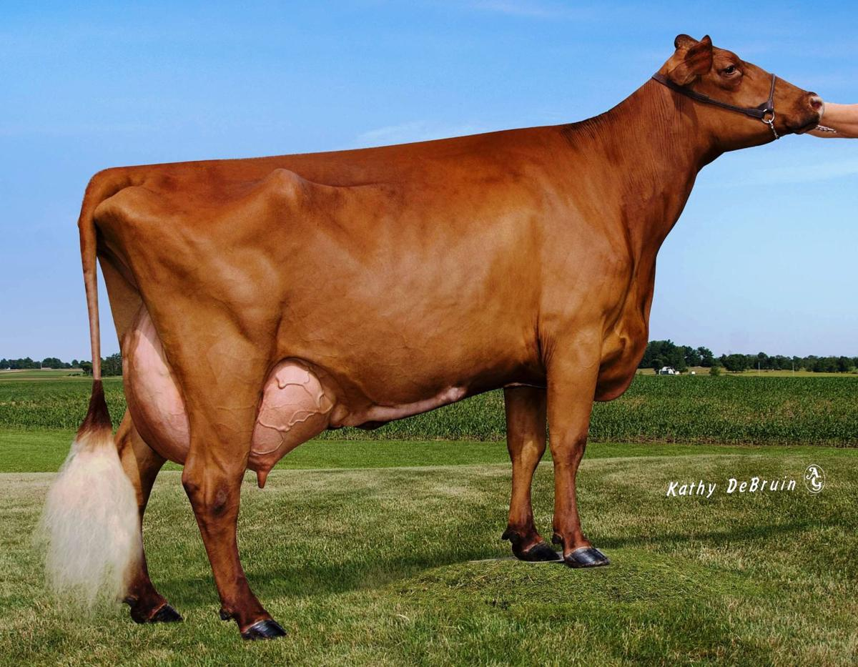
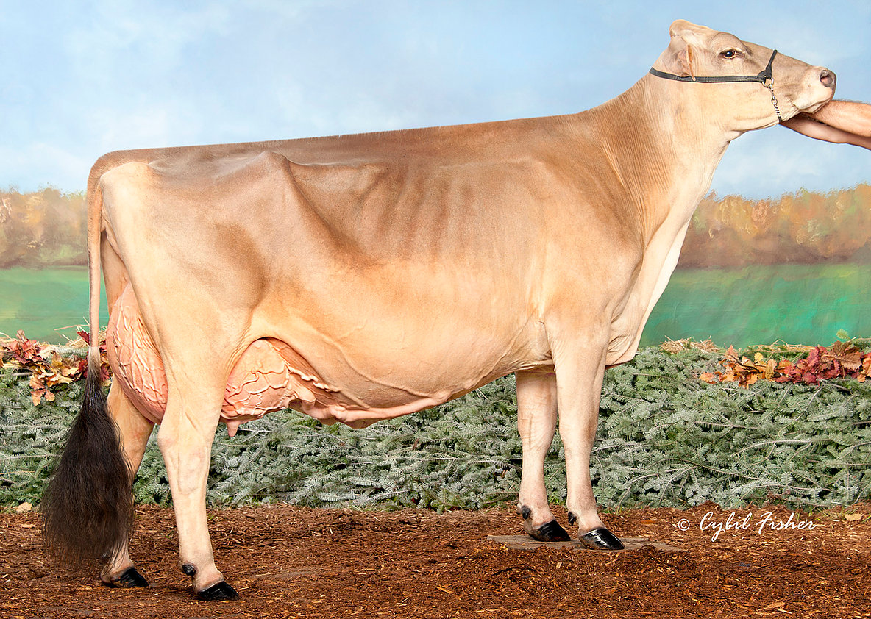
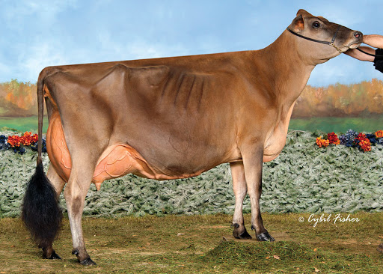
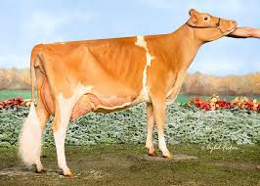
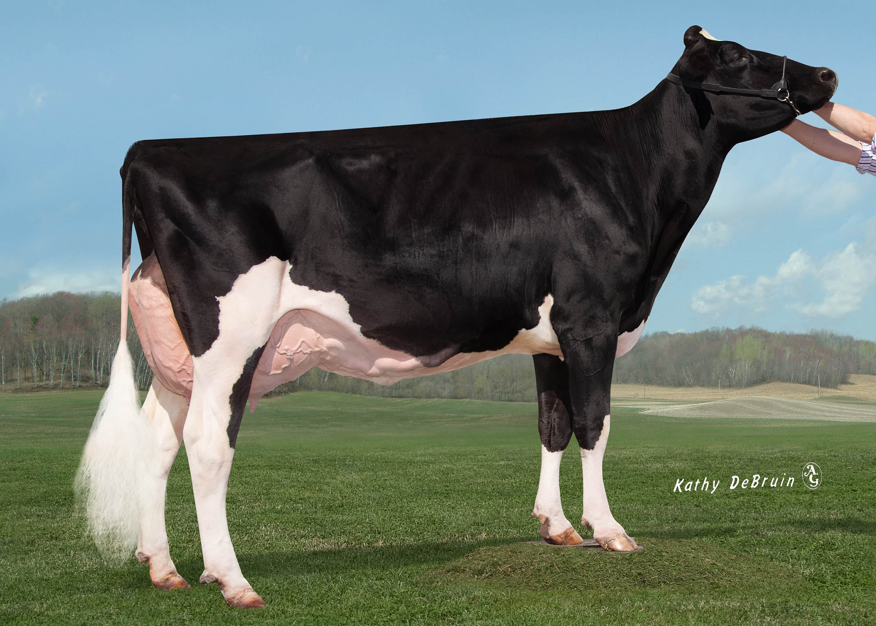
Ayrshire
Dairy Breeds of North America
Brown Swiss
Milking Shorthorn
Jersey
Guernsey
Holstein

Slide 7
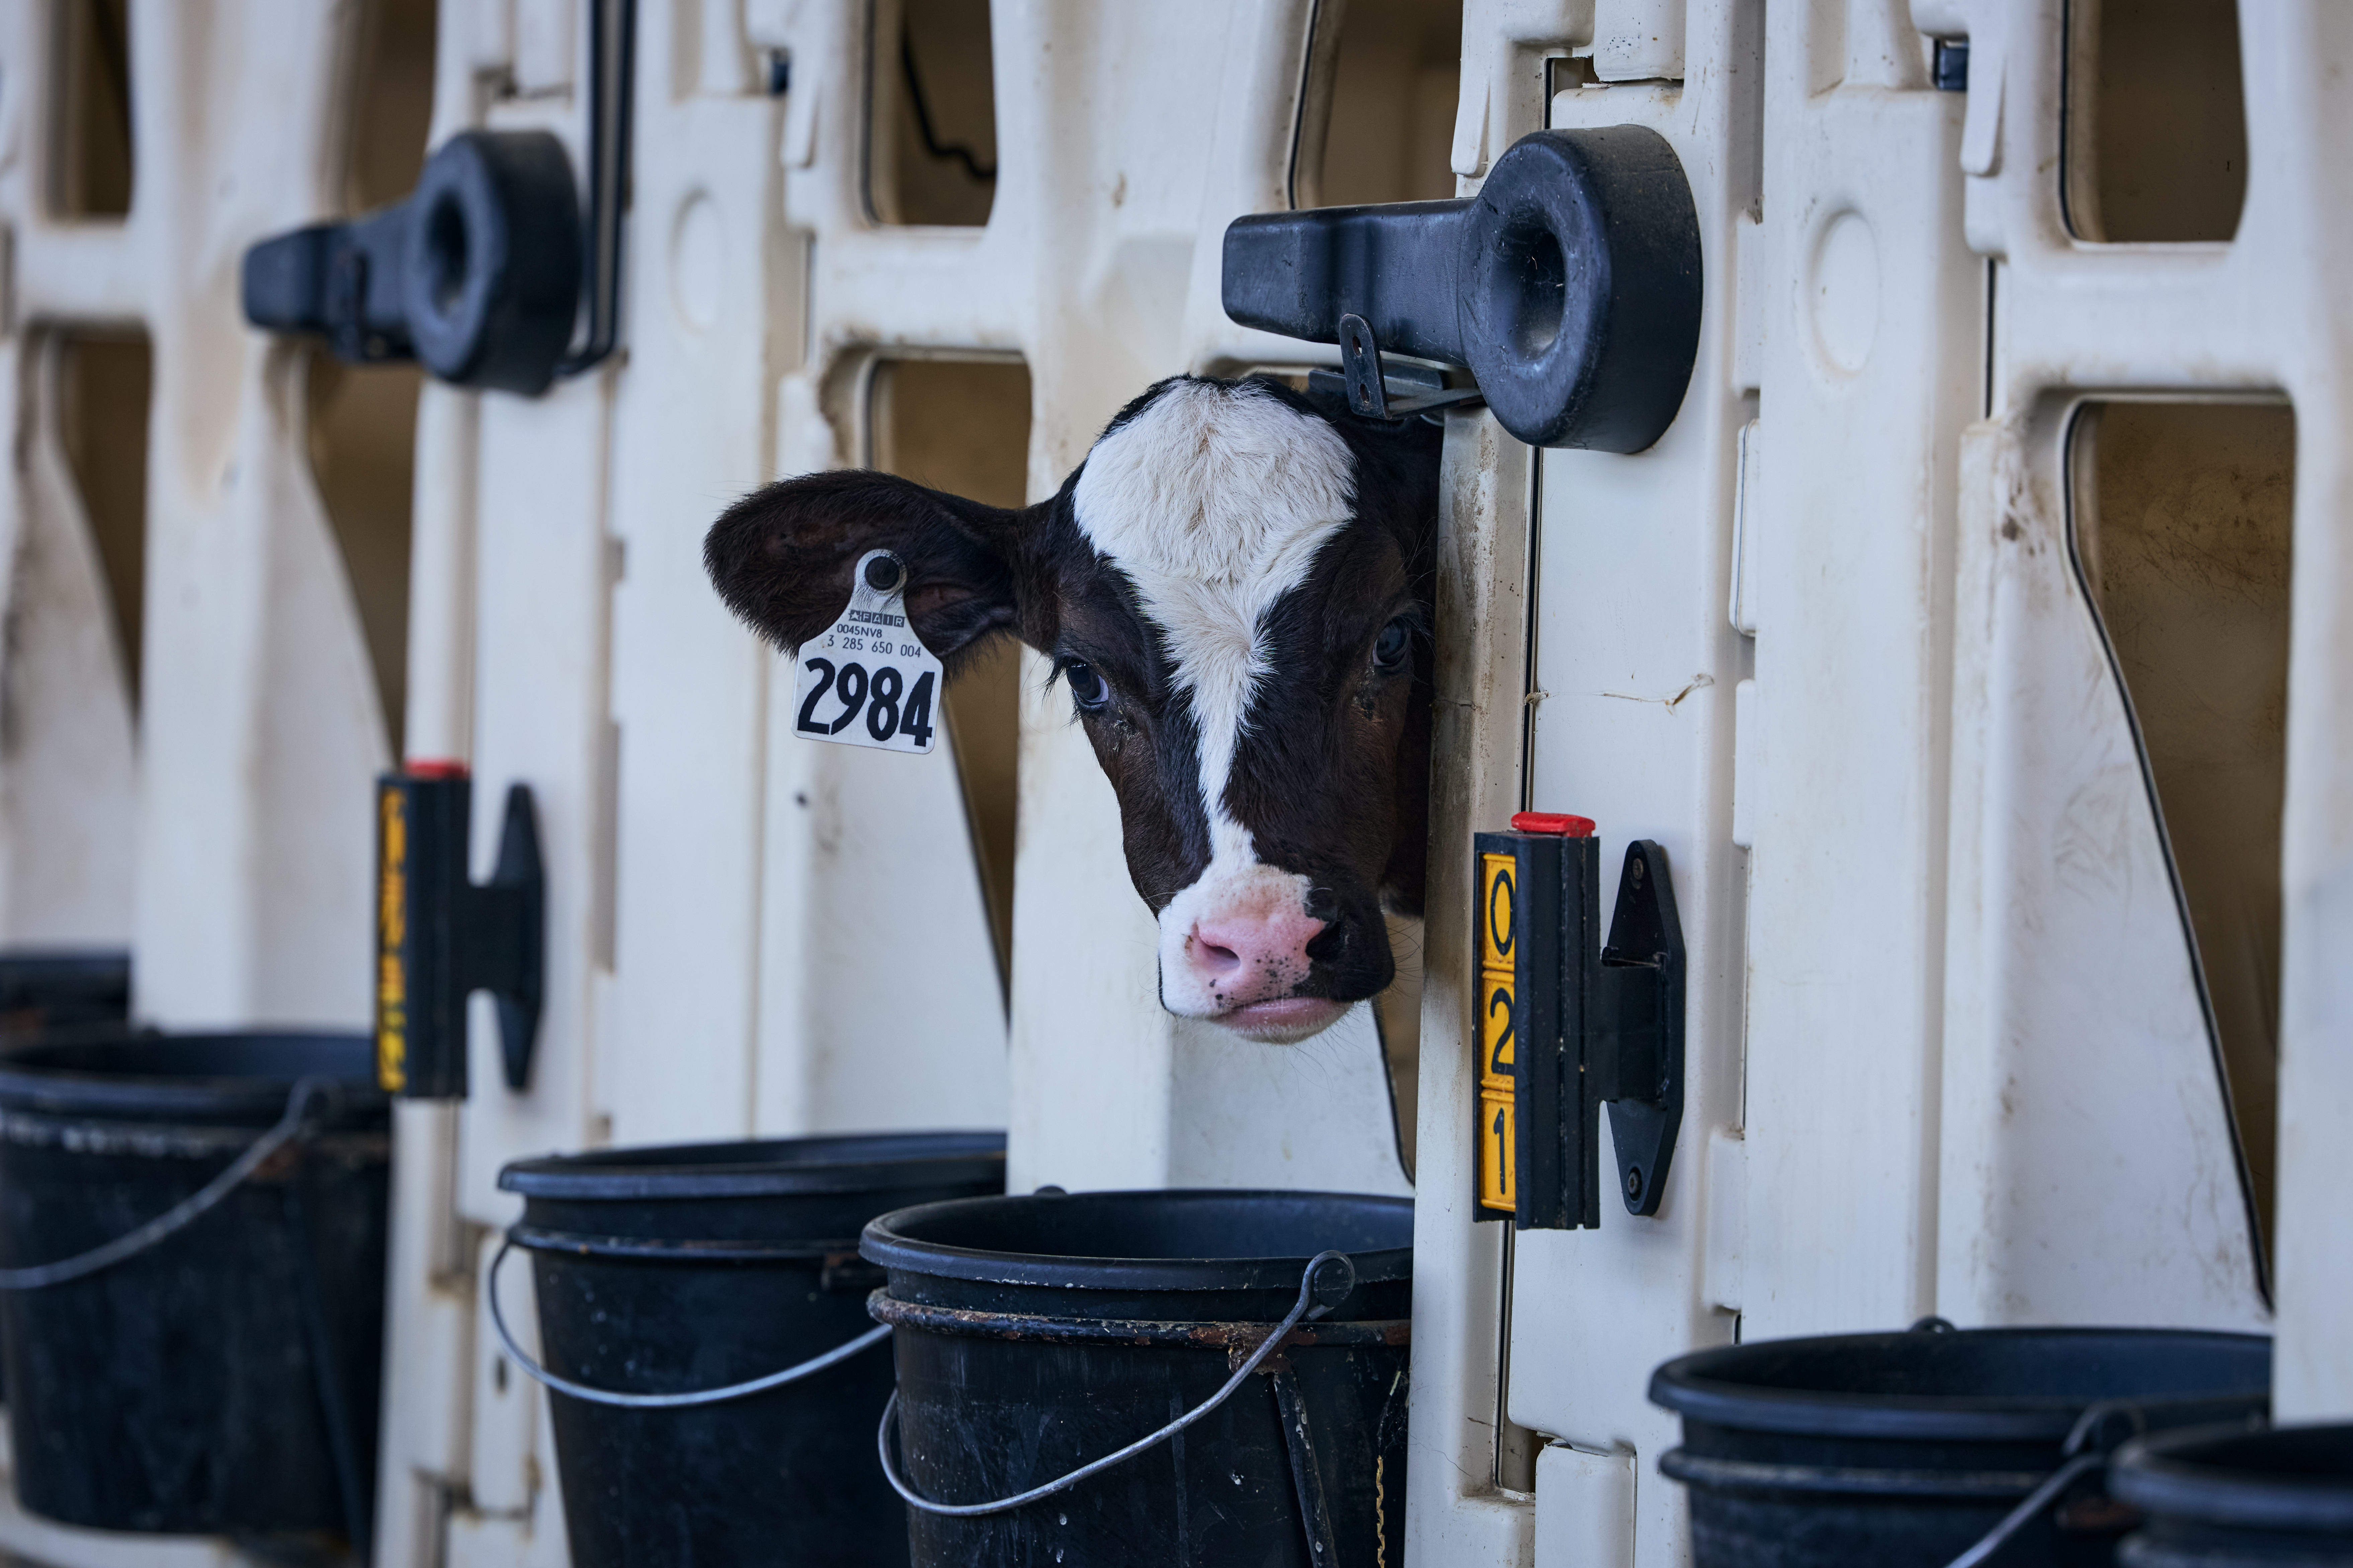
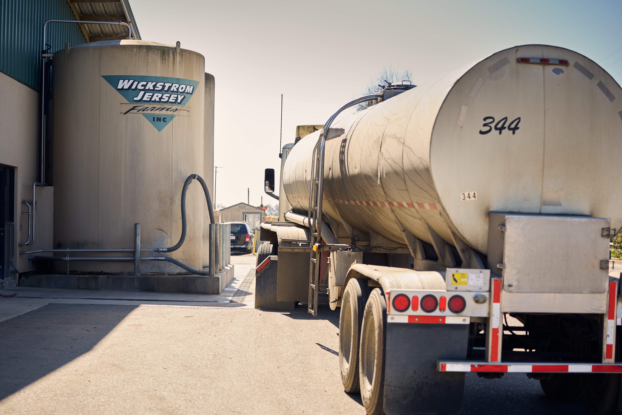
Luck E Farm (IL)
Wickstrom Jersey Farm (CA)
Andersen Farm (ID)

Slide 8
How has productivity changed over time?

Slide 9
Where are we today?
1890 avg. milk production¹
2025 avg. milk yield (HO)²
2,399 lbs/yr
26,328 lbs/yr
!!! DISCLAIMER: many factors have changed in data recording and standardization over this 130-year period !!!
However, unmistakable progress has been made. How?
(1) genetic selection & (2) improving the environment of dairy cows
¹Hodgson (1956)
²CDCB WebConnect (2022)

Slide 10
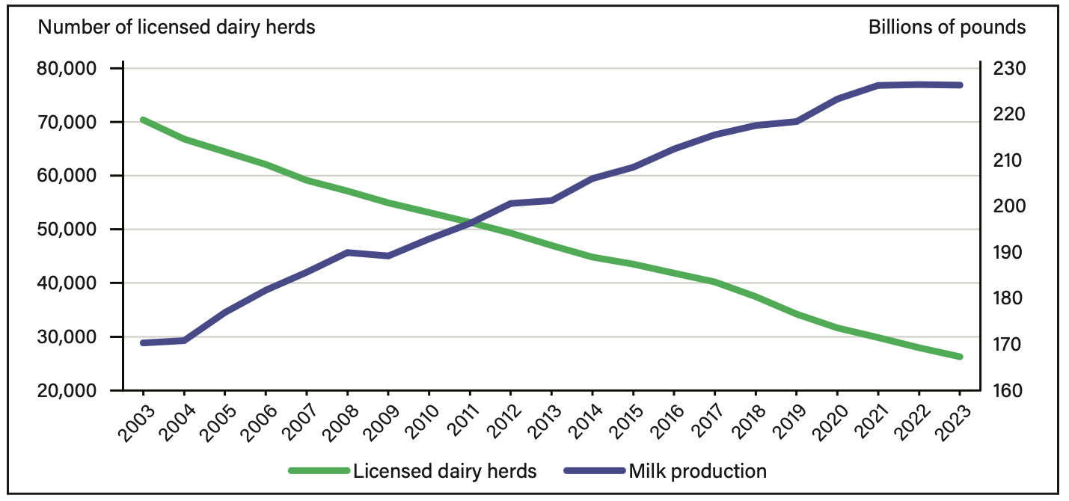
Milk production and herds (2003-2023)
USDA-ERS Report ERR-334

Slide 11
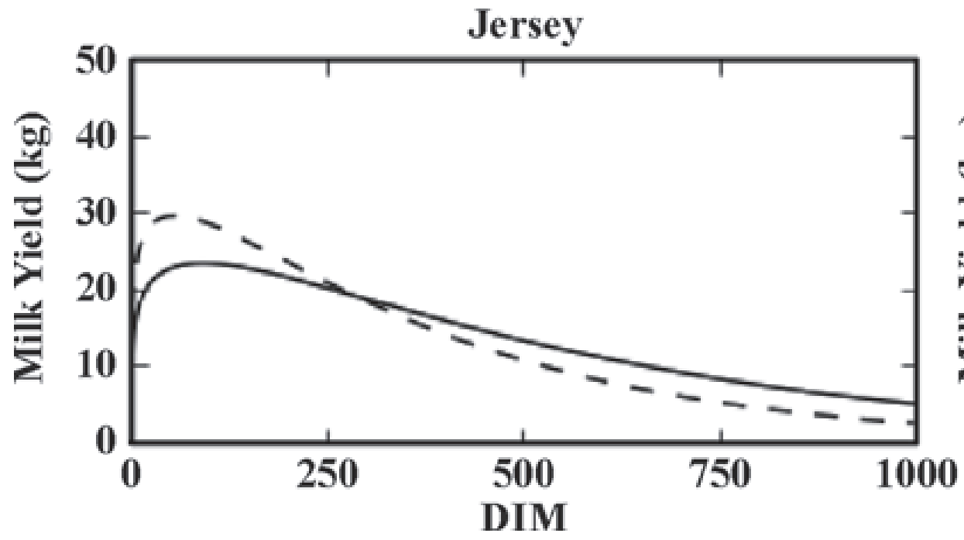
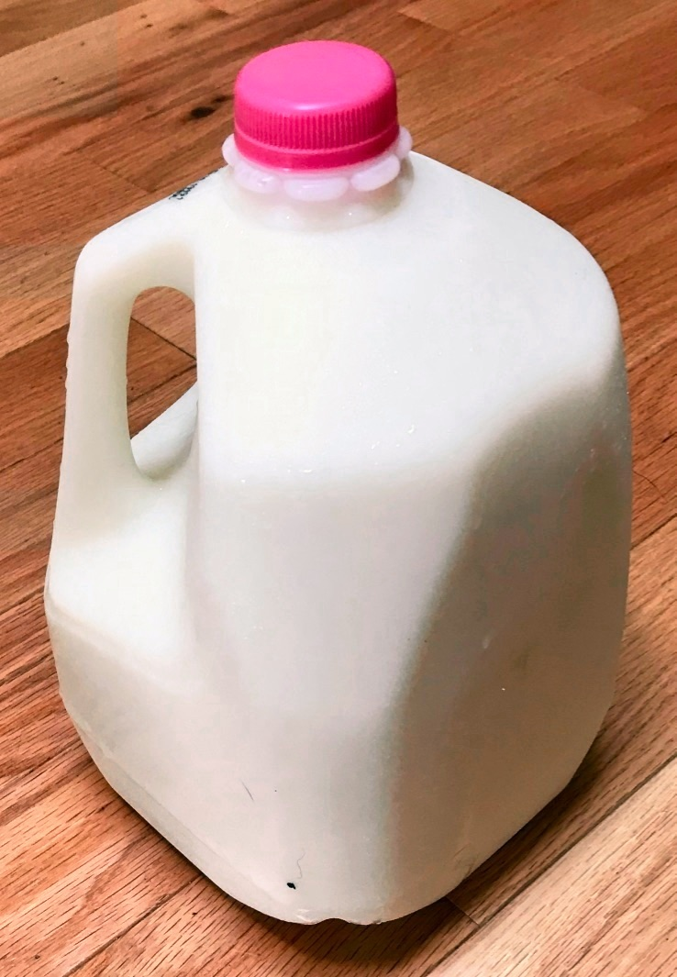

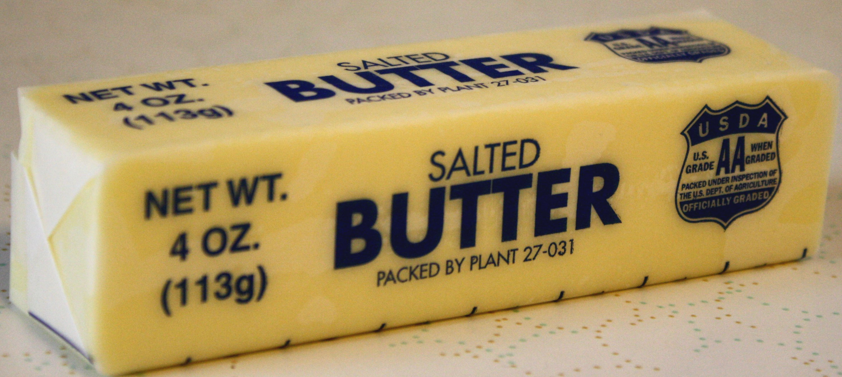
Daily production
A Holstein cow producing 26,328 lbs
of milk per year averages 86 lbs of milk, 3.6 lbs of fat, and 2.8 lbs of protein a day
This is equivalent to:
  10 gallons of milk, or
  ~9 pounds of cheddar cheese, or
  ~4 pounds of butter

Slide 12
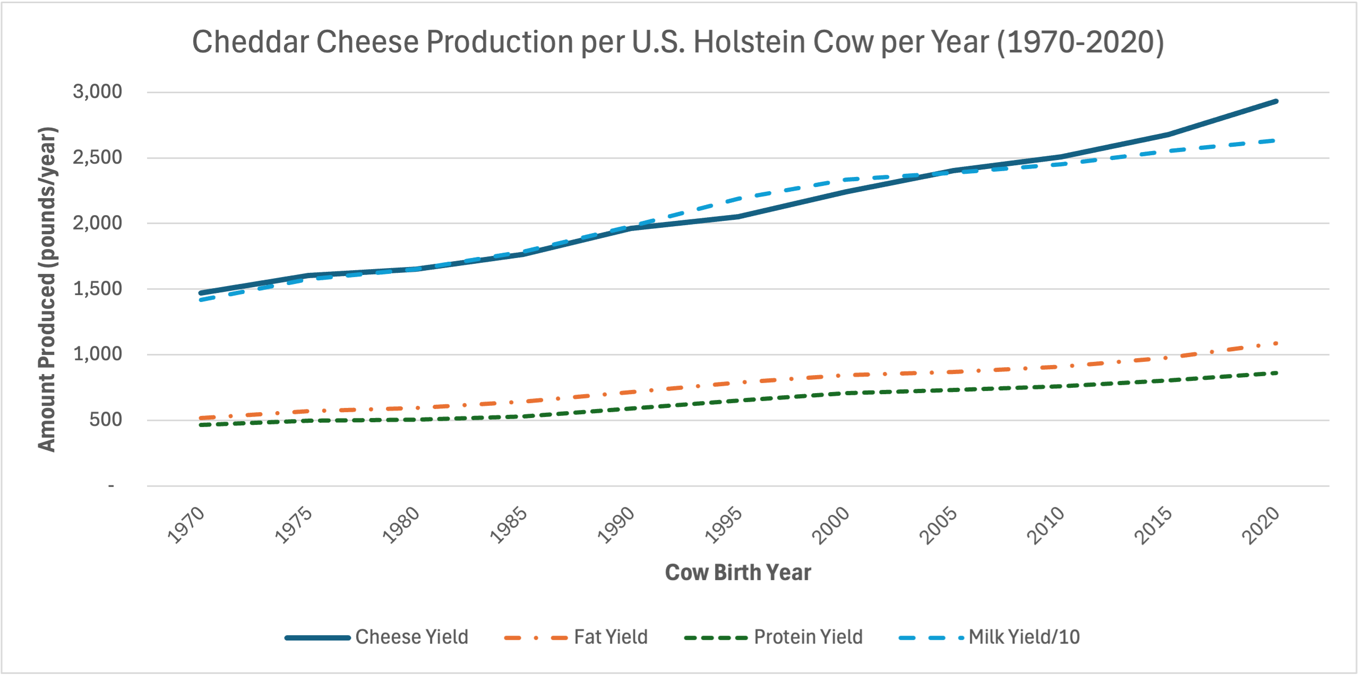
CDCB (https://webconnect.uscdcb.com/#/summary-stats/genetic-trend)

Slide 13
What contributes to these gains?
Since 1957, management (dark blue) was 28% of gains, and genetics (light blue) was 71% of gains
CDCB (https://webconnect.uscdcb.com/#/summary-stats/genetic-trend)

Slide 14
What made these gains possible?

Slide 15
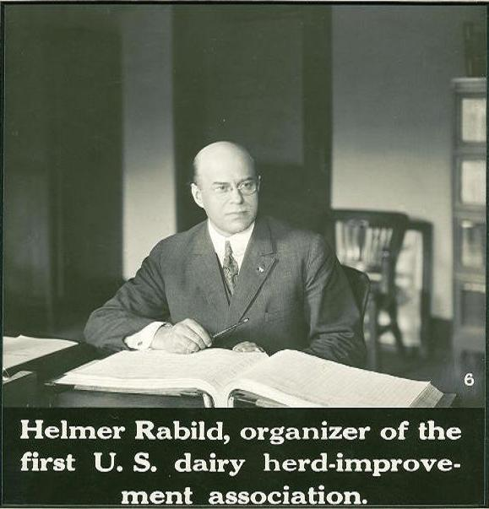
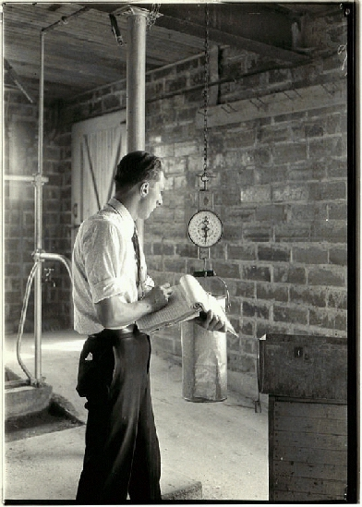
Helmer Rabild
Organized DHI in
Michigan, 1905
DHI supervisor recording milk weights

Slide 16
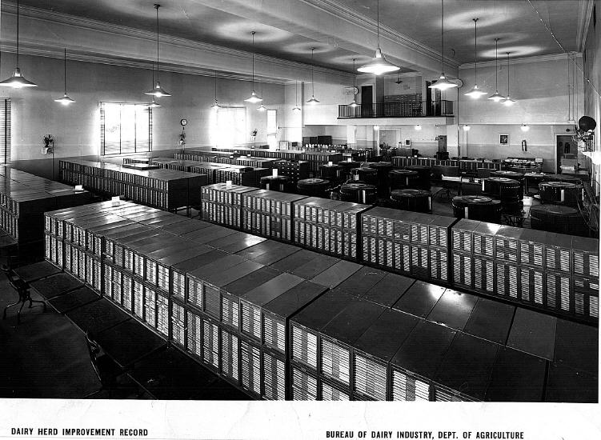
Dairy Herd Improvement Records, 1935

Slide 17
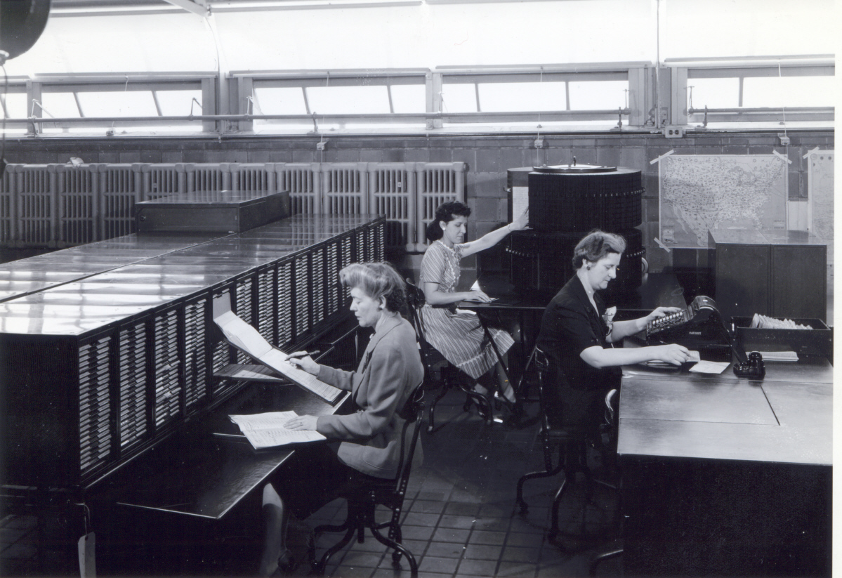
USDA DHI Record Processors, 1935

Slide 18
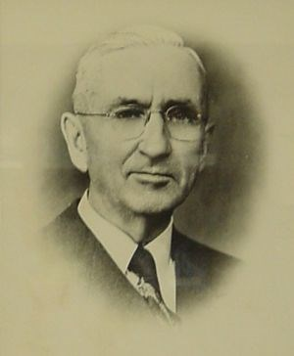
Artificial insemination was transformative
Enos Perry of Rutgers University established the first AI cooperative in the US in New Jersey in 1938
Artificial insemination (the original AI) let
farmers use the best genetics regardless of
their location
The best bulls have more than 1 million
daughters, instead of a handful
Enos Perry (Courtesy of Harold Hafs)

Slide 19
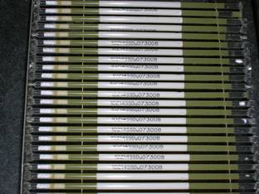
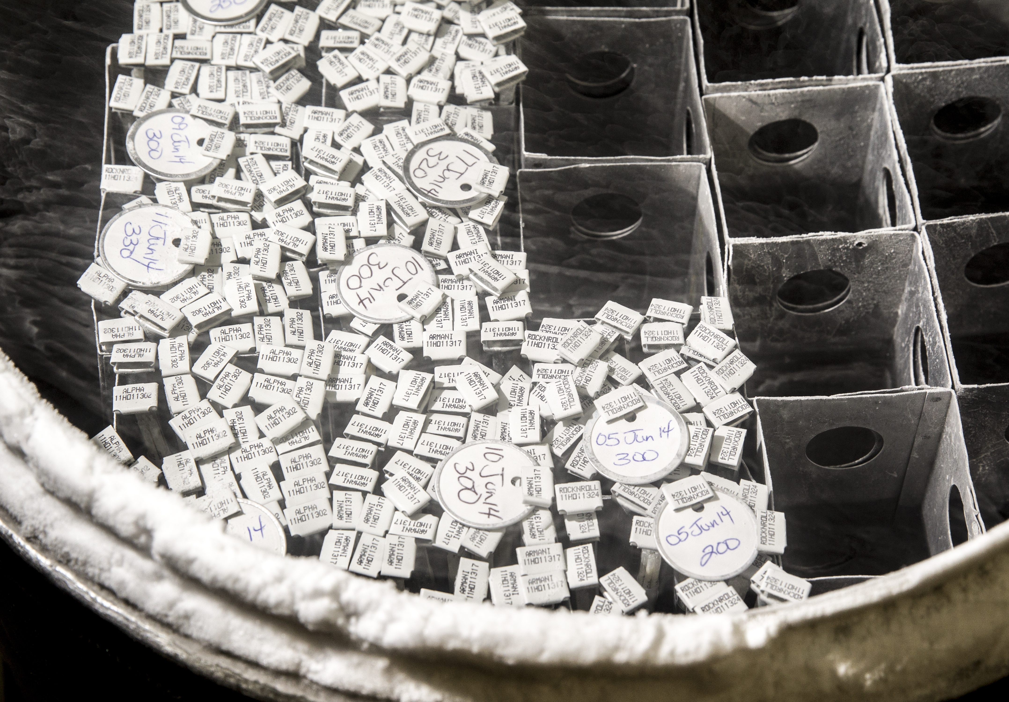
How does AI work?
Germplasm is collected from the best bulls in the population and packaged into plastic straws imprinted with the bull’s identity and the source of the genetics
The straws are sold to farmers and stored in liquid nitrogen until used to breed cows
This is a cost-effective system for distributing genetics used around the world
  In 2024, US companies sold 16.2 M units domestically and 20.8 M units internationally (Source: National Association of Animal Breeders)

Slide 20
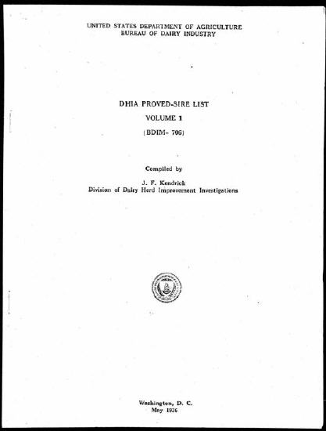
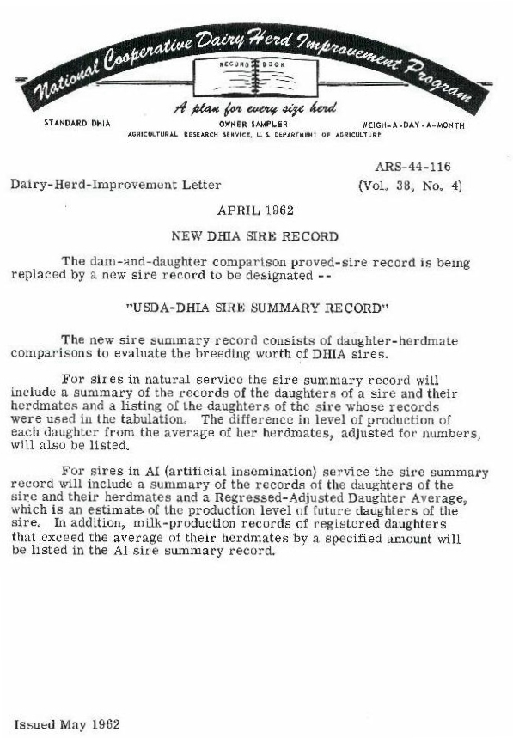
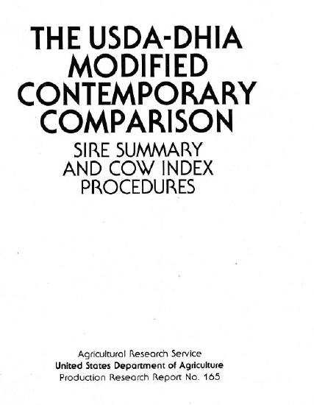
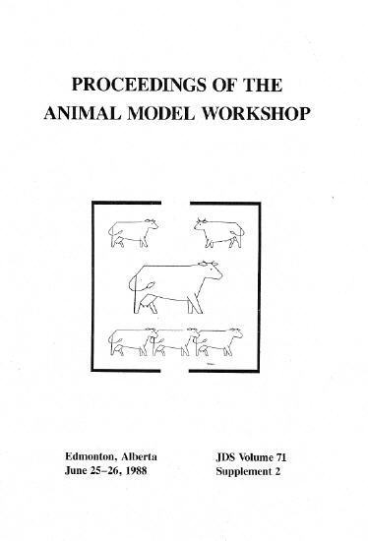
Advances in genetic evaluation methods
Proved Sire List
Volume 1, 1936
Modified Contemporary Comparison
March 1976
Dairy Herd Improvement Letters (AIPL reports)
April 1962
Animal Model
June 1988

Slide 21
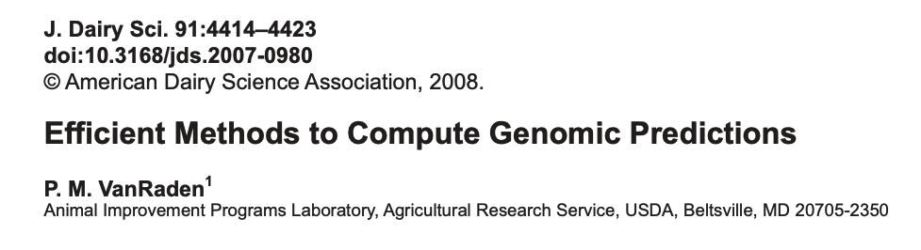
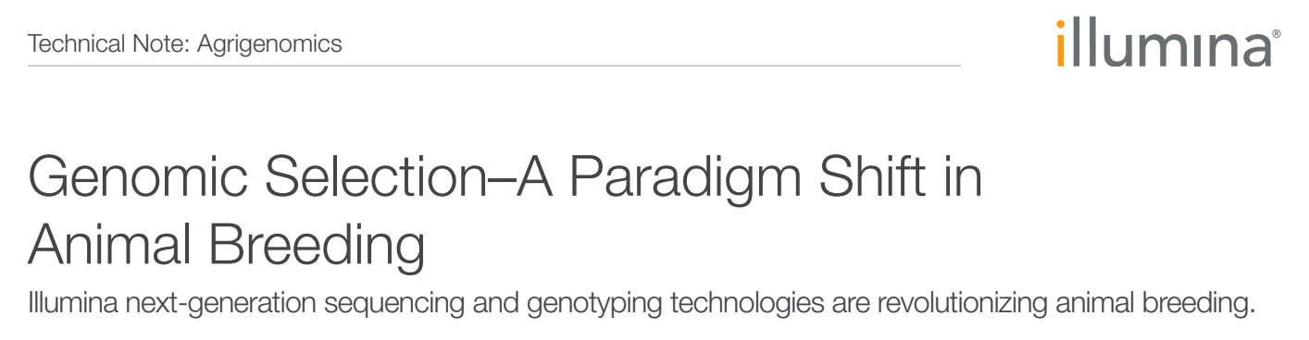
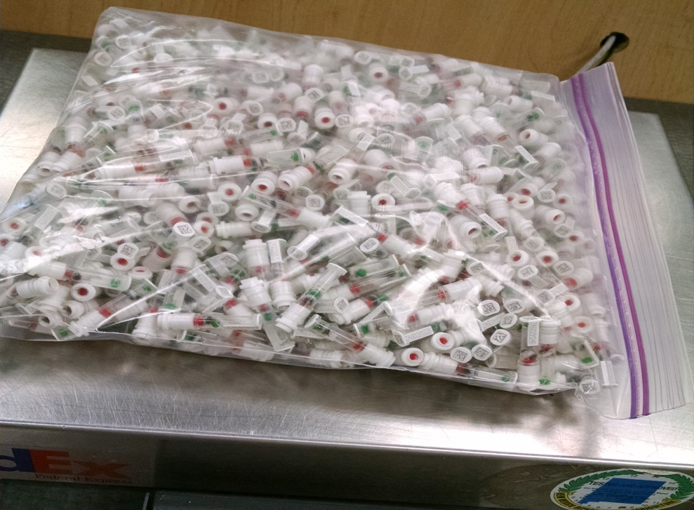
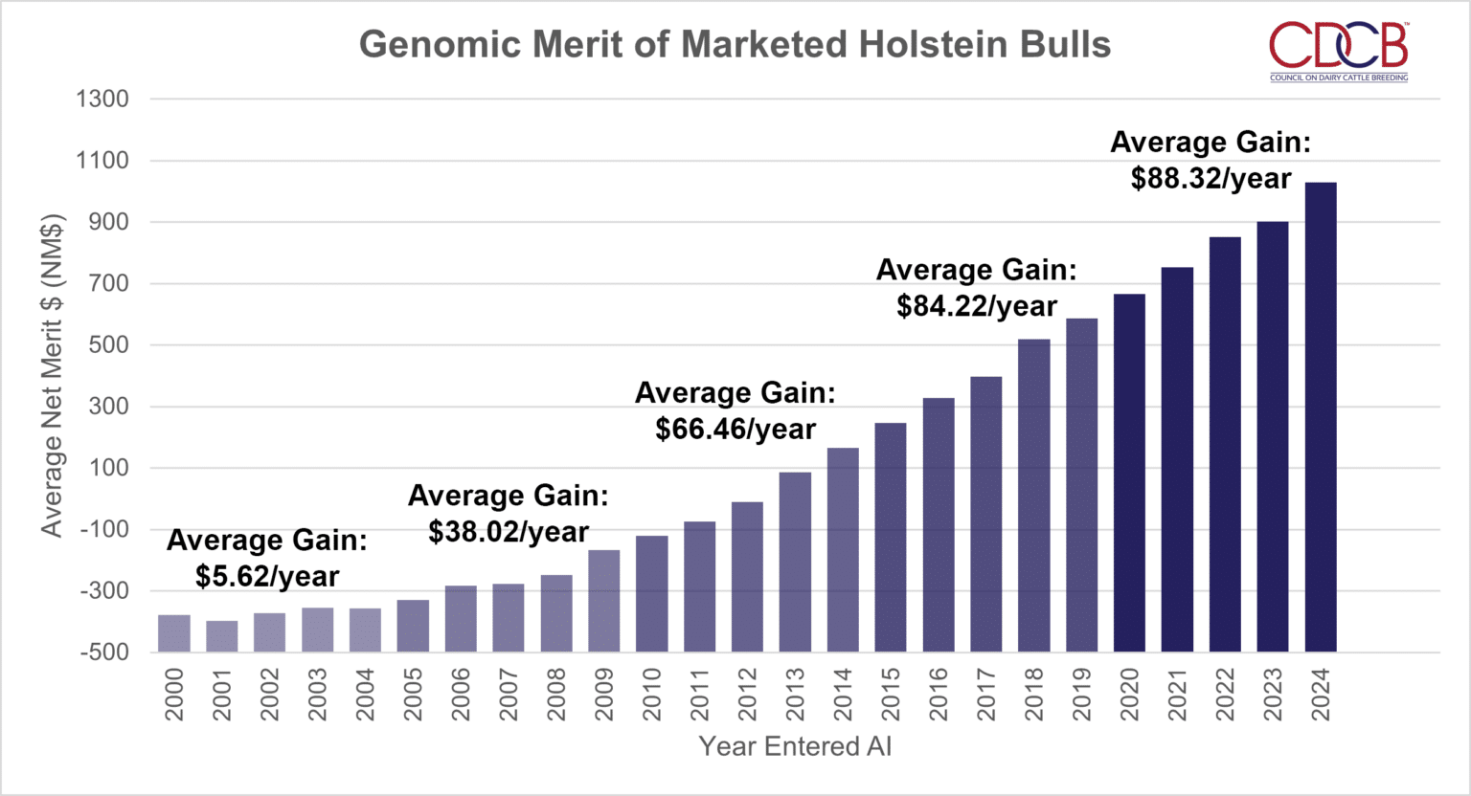


Slide 22
Who is CDCB
Steward of the National Cooperator Database
Research
and Development
Genetic Evaluation Services

Slide 23
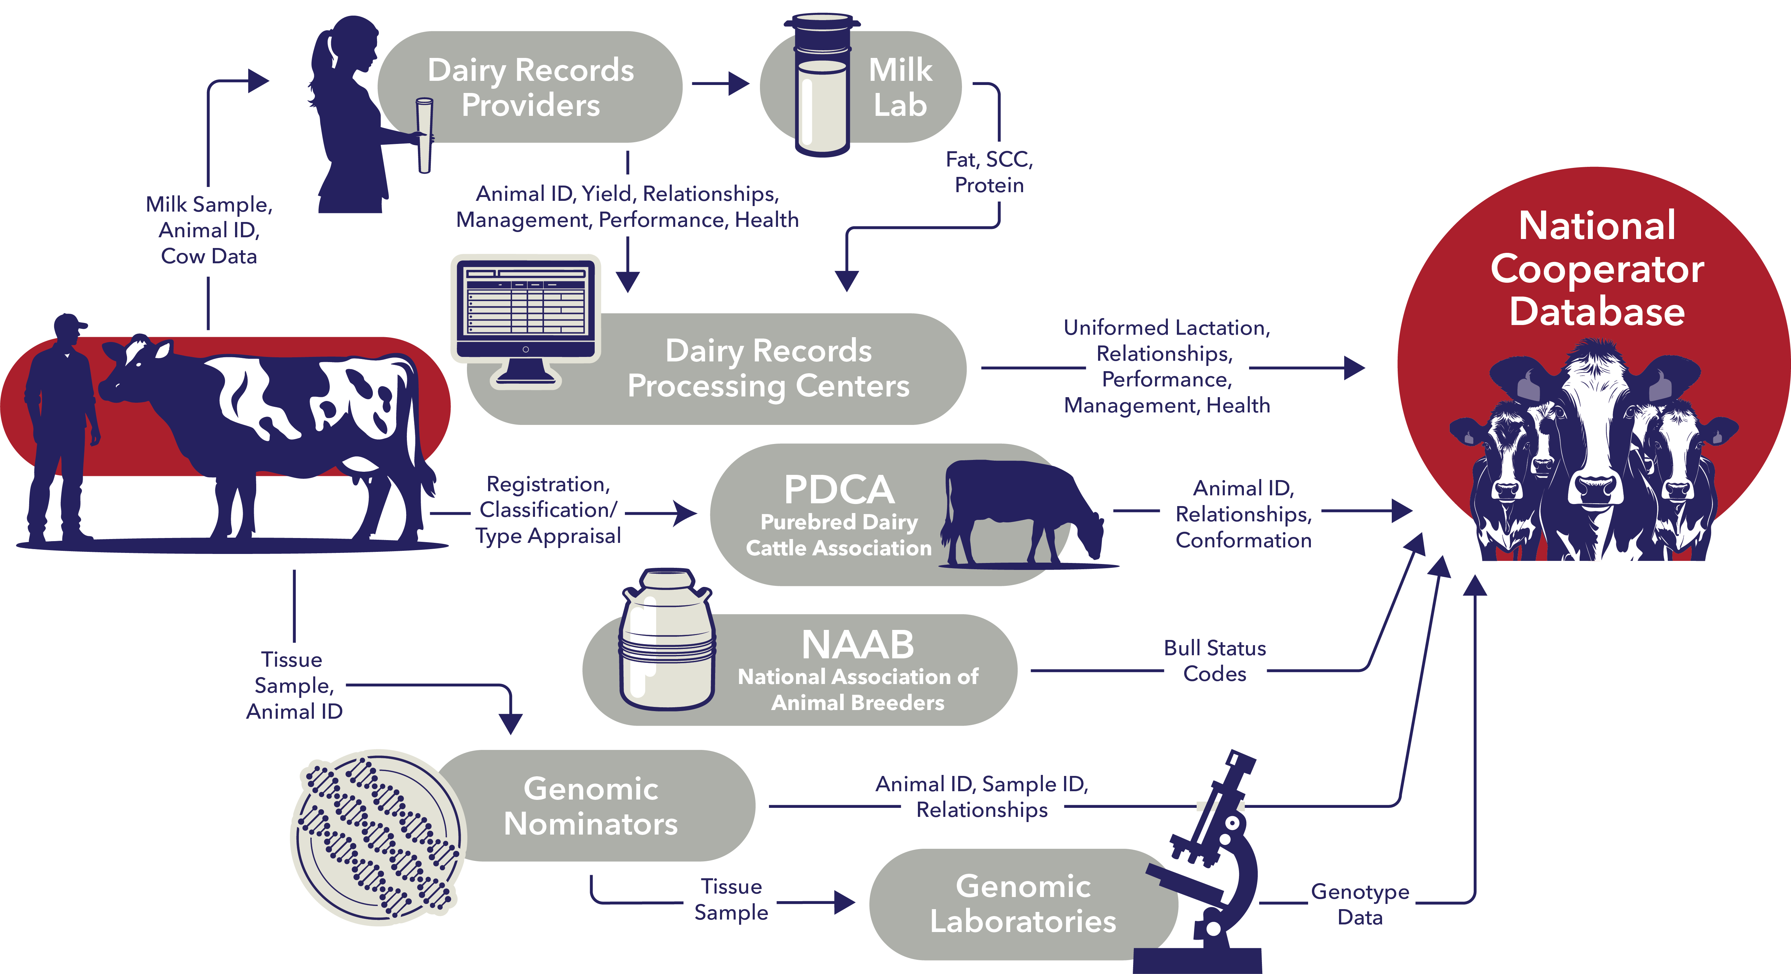

Slide 24
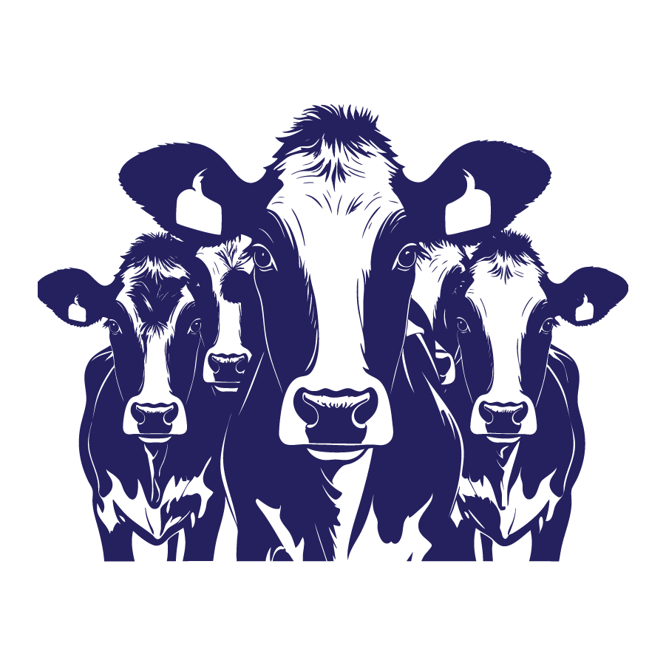
Farms Contributing
to the National Cooperator Database in 2025
The Cows
47
9,289
26,136 lbs.
States
Herds
Average Milk
(+211 lbs. over 2024)
3.79 Million
4.24%
Average Fat
Cows submitting yield data
(+0.09% over 2024)
3.24%
64%
of Cows in Herds with >1,000 Cows
Average Protein
(+0.04% over 2024)

Slide 25

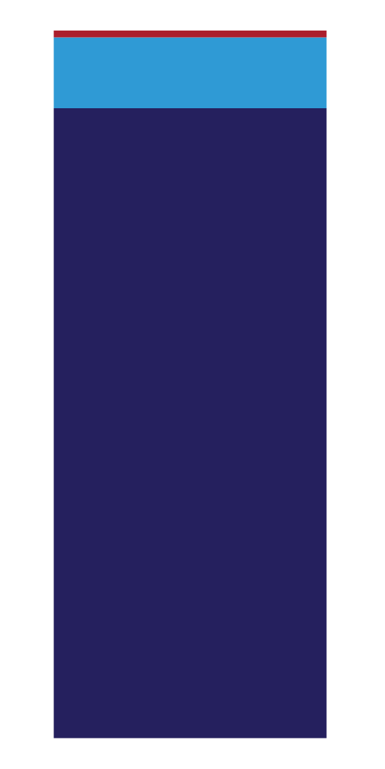

National Cooperator Database
10%
JERSEY
93%
76
88%
HOLSTEIN
COUNTRIES
FEMALE
USABLE GENOTYPES (August 2025)
Ayrshire 20,584
(+831 over 10/24)
Brown Swiss 90,892
(+10,009 over 10/24)
Guernsey 11,511
(+1,349 over 10/24)
Holstein 9,250,379
(+1,361,446 over 10/24)
Jersey 937,805
(+81,665 over 10/24)
Crossbred 384,180
(+16,367 over 10/24)

Slide 26
National Cooperator Database
Lactation
111.2 million
SCS
74.6 million
Cow Livability
130.2 million
Fertility
102.5 million
Health Traits
13.4 million
Calving Ease
40.8 million
Future Calf Health Traits (HO and JE)
208K diarrhea records
682K respiratory records
Type (non-HO)
3.7 million
Residual Feed Intake
11,800
Counts from December 2025 evaluations
Notes:
5. a/b We will have April data a week prior to the event

Slide 27
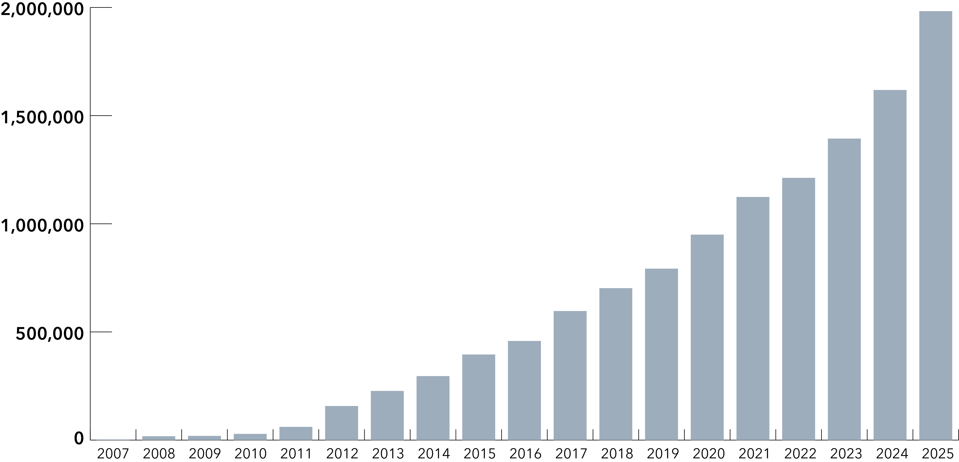
Genotypes Entering by Year

Slide 28
What will the future look like?

Slide 29
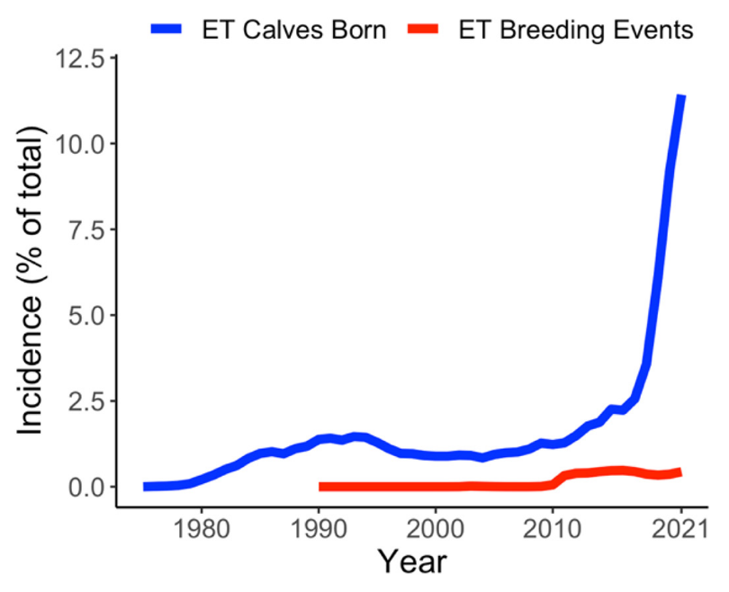
Replace semen with embryos
The # of embryo transfer calves born
is growing rapidly
Dairy embryos can increase rates of genetic improvement
Terminal beef calves are desirable in
beef-on-dairy systems
Costs are high and technicians are valuable
Source: Miles et al., 2023, https://doi.org/10.3168/jds.2022-22298

Slide 30
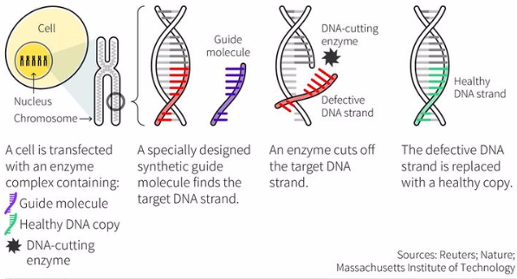
What is gene editing?
Precisely targeted changes to animal genomes
    Polled (lack of horns)
    Slick (heat tolerance)
    Disease resistance (health & welfare)
    Marbling/tenderness (meat quality)
Does not involve the transfer of
genes among species

Slide 31
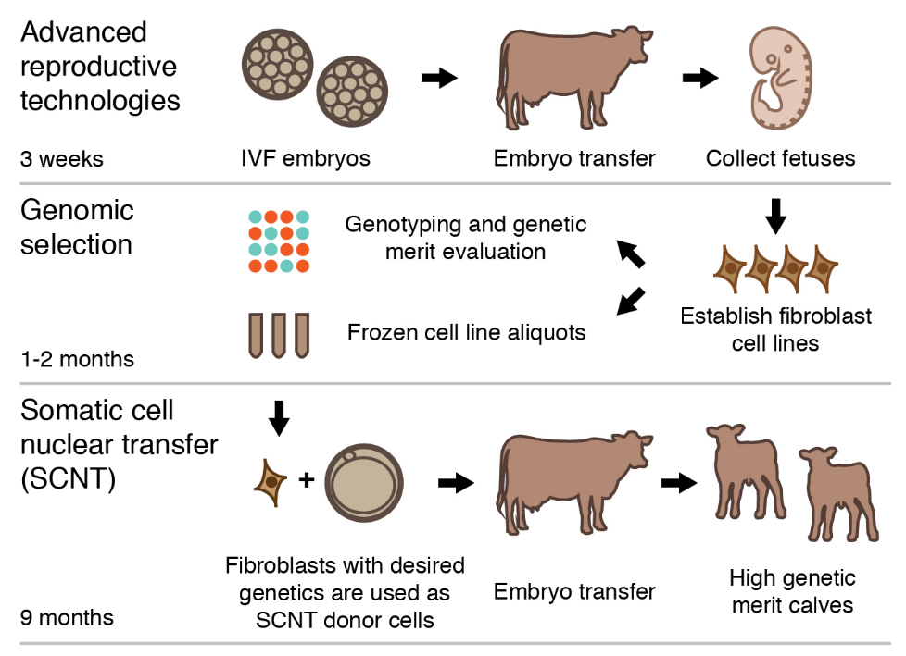
Cloning by somatic cell nuclear transfer
…
Affordable for high-value animals
Limited potential in the genomic
era because generations turn over so
quickly
Often used along with other
technologies
Source: Kasinathan et al., 2015, https://doi.org/10.1038/srep08674.

Slide 32
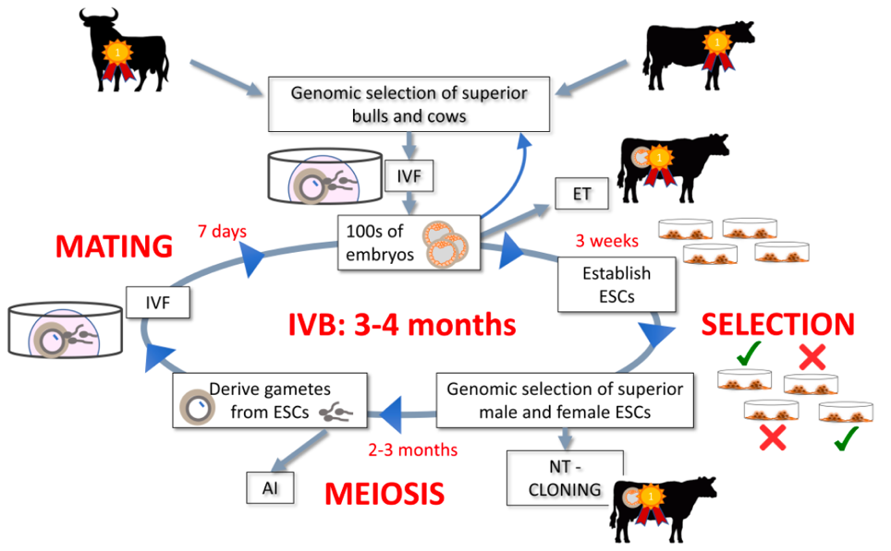
In vitro breeding
Embryonic stem cells are
turned into sperm and eggs and
used to create the next generation
This increases the rate of genetic gain because it happens very quickly in a laboratory
Clones are created after several generations of selection
This is really, really difficult and may never actually work!

Slide 33
Closing thoughts
Over 65 years, milk production per cow has more than doubled
The dairy industry has developed a successful, cooperative system for collecting data from farms across the US
These data support research into genetic improvement as well as farm management
Premium genetics require outstanding environments

Slide 34
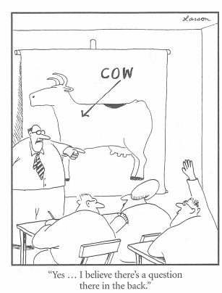
Questions?
Thank you for your
interest!
john.cole@uscdcb.com

